Slide 1
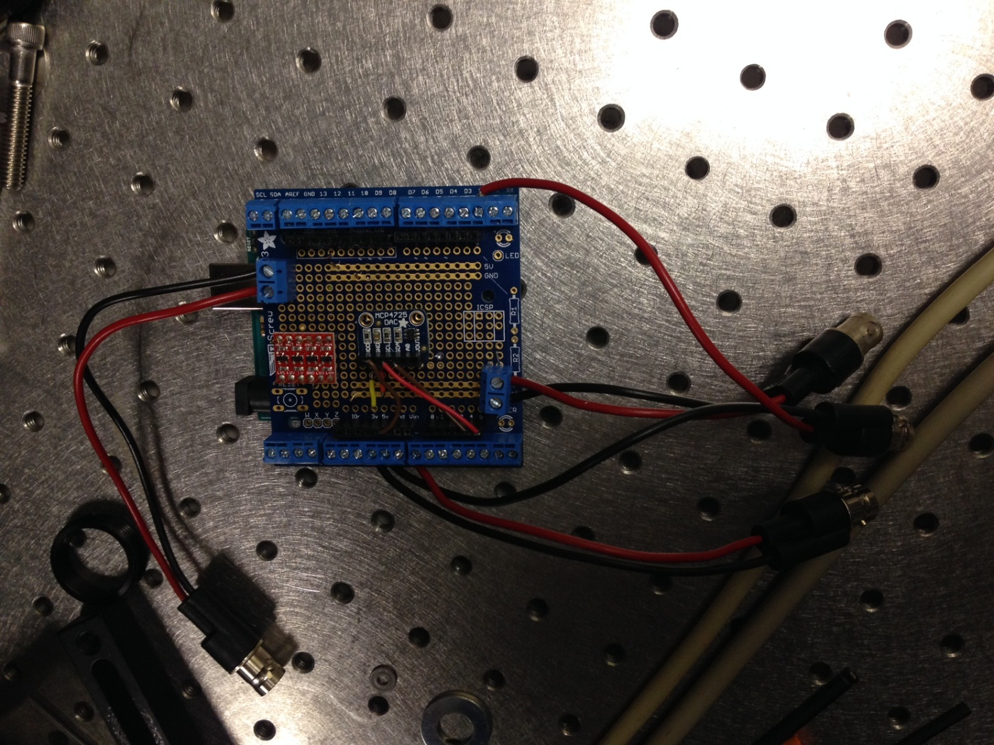
Figure 1: Arduino schematics and soldering
DAC Analog output
DAC
Camera trigger input

Slide 2
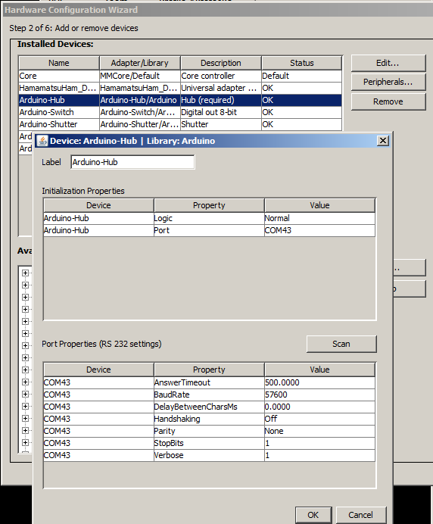
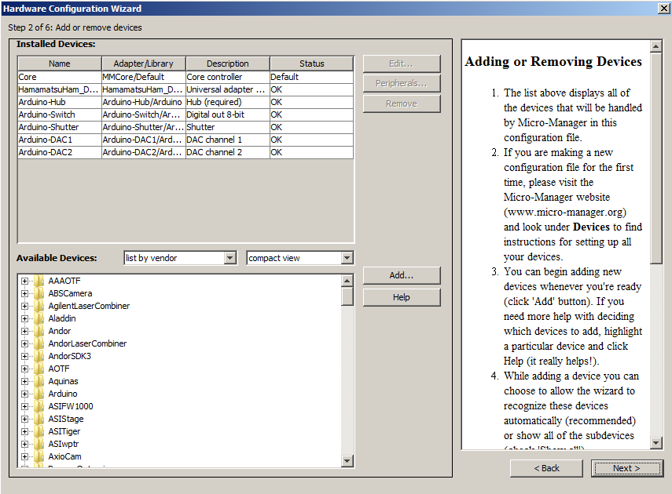
Figure 2: adding Arduino to uManager
“Peripherals” should have at least Arduino-DAC1 selected

Slide 3
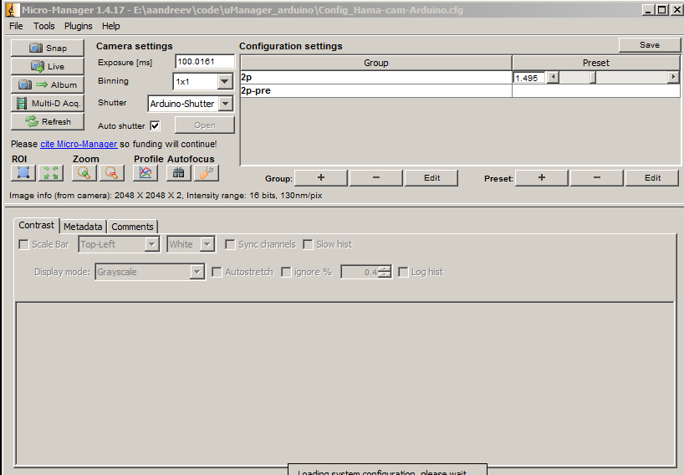
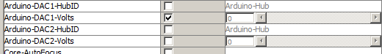
Figure 3: Setting proper groups/presets

Slide 4
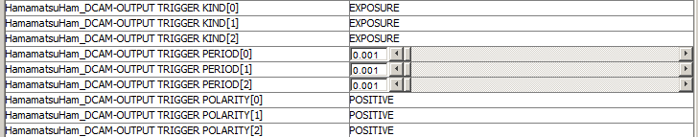
Figure 4: Setting Hamamatsu camera properties
Trigger used for masking Arduino analog output should be set Exposure/Positive; other don’t matter for this device

Slide 5
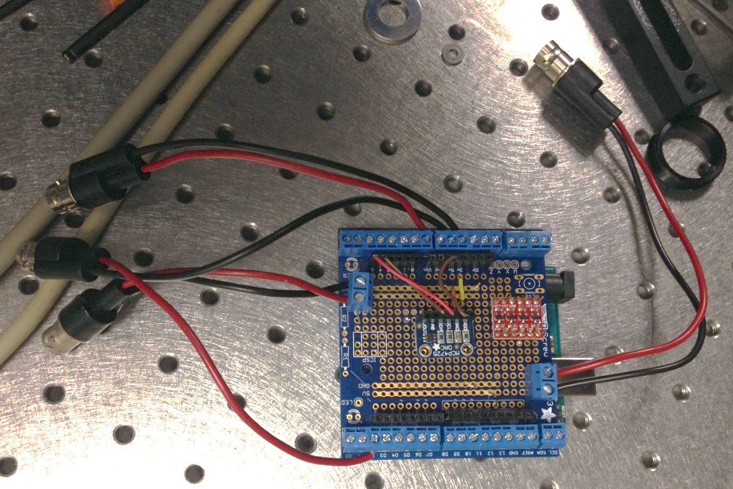
Figure 5: Connecting Arduino to camera and Pockels cells
Camera
DAC Analog output
D2
DAC
Pockels cell
DAC
Camera trigger input
1.75" Panel, 16 BNC Adapters Insulated (50 Ohm)
http://www.l-com.com/patch-panel-server-rack-175-panel-16-bnc-adapters-insulated#
BNC patch-panel preferred, e.g. from L-Com

